Slide 1
Users & Needs
community members looking for assistance – looking for organizations offering aid, and to sign up for aid through the mutual aid form
community members looking to help – looking for ways to volunteer, donate resources in the community (through the mutual aid form or independently of the form)
lead organizer(s) and block leaders – looking for community members that need assistance, matching those that need aid with those that can provide aid, evaluating urgent needs, ongoing needs, etc.
other organizers – looking to spread the word about organizations in the community (independent of the mutual aid network) that are providing aid, looking to recruit volunteers
search engine – looking for well-structured content and data

Slide 2
Focus Pages
complete/update the mutual aid form (for community members looking for aid and/or offering aid)
asks page (for community members offering aid) where users can see the specific needs of other community members (based on data from the form)
find out information about other organizations or aid groups (school meals, hot meal delivery, etc.)
lead organizer(s) & block leaders –sign-in page to view more detailed content about specific user asks, what needs have been fulfilled, what needs are most urgent, see more detailed contact info, etc.
becoming a block leader – page devoted to information about becoming a block leader and place to input their information to be sent to lead organizer(s)
submit information about other organizations or request volunteers (based on what aid community members have offered to give through the form)

Slide 3
Basic Pages
Home page – (with the form at the bottom)
About page – mission, vision, lead organizer(s)’ and block leaders’ information
Help – send email with specific questions or concerns (possibly offer phone numbers & available times to talk)
Donate – sends you to a page with information about how to donate to the collective pot

Slide 4
Sitemap
Help Login Donate Translate
Update Form
Needs and Offerings
Community Resources
Add Resource Form
Become a Block Leader
About
Home
Form

Slide 5
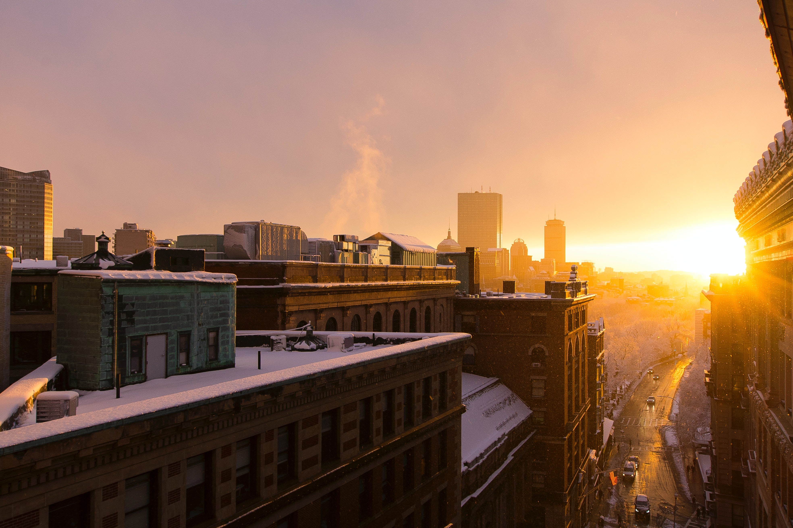
DORCHESTER COMMUNITY CARE NETWORK
Donate
Login
Help
Translate
Complete Form
Update Form
Volunteer
Community Resources
Become a Block Leader
About Us
The Dorchester Community Care Network is working to make sure you and your neighbors have everything you need during the COVID-19 pandemic. In these fast-moving and uncertain times, it’s important that we show up for each other and remember that we are not alone. We love our neighborhood and the people in it.
The form below started off as a Google Form used to collect information about the specific needs and offerings of individuals and households. We have moved to this web form and this website to better handle the data and track ongoing needs and offerings.
You can complete the form below without signing up with a username and password, but you must have a login to edit the information on the form after submission. We suggest signing up and logging in before completing the form.
(see next slide for page view when user scrolls down)
Notes:
HOME PAGE

Slide 6
DORCHESTER COMMUNITY CARE NETWORK
Donate
Login
Help
Translate
Complete Form
Update Form
Volunteer
Community Resources
Become a Block Leader
About Us
COMPLETE THE FORM BELOW
Name
Pseudonym (not required – what will appear publicly, if left blank, Name entry above will be used)
Phone Number (will not be shared publicly)
Address (will not be shared publicly)
ETC.
Full Name or Household Name
Pseudonym
(XXX)XXX-XXXX
Number + Street Name
Apt. Number
Notes:
HOME PAGE

Slide 7
DORCHESTER COMMUNITY CARE NETWORK
Donate
Login
Help
Translate
Complete Form
Update Form
Volunteer
Community Resources
Become a Block Leader
About Us
UPDATE YOUR FORM
Name
Pseudonym (not required – what will appear publicly, if left blank, Name entry above will be used)
Phone Number (will not be shared publicly)
Address (will not be shared publicly)
ETC…
Melissa Sawyer
Pseudonym
(440)864-8409
14 Edwin Street
Apt. Number
Notes:
UPDATE FORM PAGE

Slide 8
DORCHESTER COMMUNITY CARE NETWORK
Donate
Login
Help
Translate
Complete Form
Update Form
Needs and Offerings
Community Resources
Become a Block Leader
About Us
Browse Individual Needs and Offerings Below
ETC.
Name | Contact Email dorchestercommunitycare@gmail.com for contact information if not listed. | Offerings What they’ve indicated they need or are looking for. Sort by ↓ (dropdown menu) | More Information on Offerings | Needs What they’ve indicated they need or are looking for. Sort by ↓ (dropdown menu) | More Information on Needs
Rev. Mariama | revmariama@newroots.church | cooking for someone food & supplies internet subscriptions | I am cooking large amounts of food and could easily add enough for a couple more people if folks want prepared meals. I have food that can freeze well and I have enough Tupperware to give away that they could pick it up.
sample | sample | sample sample | sample | sample sample | sample
Notes:
NEEDS & OFFERINGS PAGE

Slide 9
DORCHESTER COMMUNITY CARE NETWORK
Donate
Login
Help
Translate
Complete Form
Update Form
Volunteer
Community Resources
Become a Block Leader
About Us
COMMUNITY RESOURCES
Many organizations are doing mutual aid work at a larger scale than at the individual level. Below, you can find out more information about these organization, what they’re offering, how to sign up for assistance, and how you can contribute as a volunteer.
ADD AN ORGANIZATION
Want to add a resource to this page? Click here to complete the form and submit it to our organizers for review.
Criteria for review:
Must be offering services in Dorchester and Mattapan
(see the slide after the next for page this links to)
INDIVIDUAL ORGANIZATION NAME
See the following slide for a better view of this box.

Slide 10
DORCHESTER COMMUNITY CARE NETWORK
Donate
Login
Help
Translate
Complete Form
Update Form
Volunteer
Community Resources
Become a Block Leader
About Us
INDIVIDUAL ORGANIZATION NAME
Information about the organization, mission statement, goals, how they’re offering help.
Link to receive services or find out more information.
How you can help: Link or information about volunteering with the organization.
Link to website
ORGANIZATION’S LOGO

Slide 11
DORCHESTER COMMUNITY CARE NETWORK
Donate
Login
Help
Translate
Complete Form
Update Form
Volunteer
Community Resources
Become a Block Leader
About Us
Block Leader Responsibilities
Short description of block leader duties
Unordered list of block leader’s responsibilities
Meeting frequency
Other duties
Interested in becoming
a block leader?
Complete the form below.
Name
Phone Number
Email Address
ETC.
Full Name
(XXX)XXX-XXXX
youremail@domain.com

Slide 12
DORCHESTER COMMUNITY CARE NETWORK
Donate
Login
Help
Translate
Complete Form
Update Form
Volunteer
Community Resources
Become a Block Leader
About Us
WHO WE ARE
We are a group of Dorchester residents, community organizers, workers who are connected to Dorchester Not for Sale, Asian American Resource Workshop, Black Lives Matter Boston, New England United For Justice and other community organizations. The group was formed in the wake of the COVID-19 crisis. (Additional about us information will be included about the mission and goals.)
Many thanks to Mutual Aid Medford and Somerville (MAMAS), who initiated creating the original tools that we adapted. To replicate it for your neighborhood, check out their how-to guide.
(See next slide for view when scrolling further down.)
Notes:
ABOUT US PAGE

Slide 13
DORCHESTER COMMUNITY CARE NETWORK
Donate
Login
Help
Translate
Complete Form
Update Form
Volunteer
Community Resources
Become a Block Leader
About Us
ORGANIZER PROFILE
Blurb about organizer.
Blocks/areas they are serving.
Contact information.
PHOTO OF ORGANIZER
ORGANIZER PROFILE
Blurb about organizer.
Blocks/areas they are serving.
Contact information.
PHOTO OF ORGANIZER
Notes:
ABOUT US PAGE

Slide 14
DORCHESTER COMMUNITY CARE NETWORK
Donate
Login
Help
Translate
Complete Form
Update Form
Volunteer
Community Resources
Become a Block Leader
About Us
Login
Welcome back. Please login to your account.
--------------------------------------------------------------- OR ---------------------------------------------------------------
Enter your email address
Password
I forgot my password.
Don’t have an account? Click here to create one:
G Login with Gmail
F Login with Facebook
youremail@domain.com
password
Login
Create Account
Notes:
ABOUT US PAGE

Slide 15
DORCHESTER COMMUNITY CARE NETWORK
Donate
Login
Help
Translate
Complete Form
Update Form
Volunteer
Community Resources
Become a Block Leader
About Us
Create an Account
Sign up using Gmail or Facebook:
--------------------------------------------------------------- OR ---------------------------------------------------------------
Enter your email address
Password
Verify Password
G Login with Gmail
F Login with Facebook
youremail@domain.com
password
re-enter password
Sign Up
Notes:
ABOUT US PAGE

Slide 16
DORCHESTER COMMUNITY CARE NETWORK
Donate
Login
Help
Translate
Complete Form
Update Form
Volunteer
Community Resources
Become a Block Leader
About Us
Need Help?
Send a question or a concern to our leaders:
--------------------------------------------------------------- OR ---------------------------------------------------------------
Contact information for a helpline here (may include phone number, hours available, translation service contacts, etc.)
Enter question or concern here.
Submit
Notes:
ABOUT US PAGE

Slide 17
FONTS
Photo by Matthew Landers on Unsplash
Purple Taupe
#513D4C
Maximum Yellow Red
#EBC043
Dark Sea Green
#86B59A
Kombu Green
#354033
White
#ffffff

Slide 18
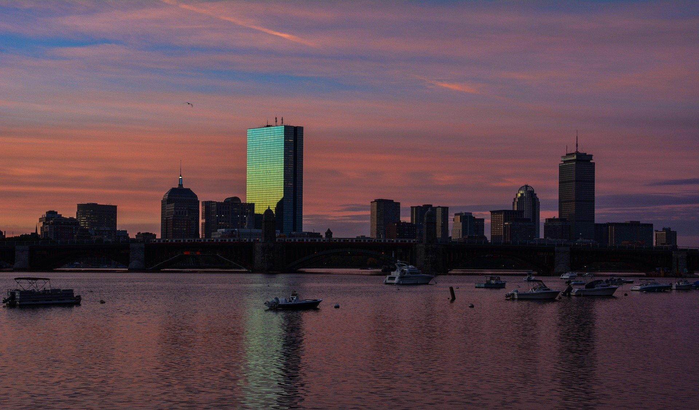
Photo by Matthew Landers on Unsplash
Image by <a href="https://pixabay.com/users/csr_ch-9840180/?utm_source=link-attribution&amp;utm_medium=referral&amp;utm_campaign=image&amp;utm_content=3834594">Christophe Schindler</a> from <a href="https://pixabay.com/?utm_source=link-attribution&amp;utm_medium=referral&amp;utm_campaign=image&amp;utm_content=3834594">Pixabay</a>

